Slide 1
Analysis Model
Analysis Model
•Analysis results in a model of the system that aims to be correct, complete, consistent, and unambiguous
•Developers formalize the requirements specification produced during requirements elicitation and examine in more detail boundary conditions and exceptional cases.
•Developers validate, correct and clarify the requirements specification if any errors or ambiguities are found.
•The client and the user are usually involved in this activity when the requirements specification must be changed and when additional information must be gathered.

Slide 2
Analysis Model
Analysis Model
•In object-oriented analysis, developers build a model describing the application domain
•The analysis model is then extended to describe how the actors and the system interact to manipulate the application domain model
•Developers use the analysis model, together with nonfunctional requirements, to prepare for the architecture of the system developed during high-level design

Slide 3
Analysis Model
Analysis Activities
•Identification of objects
•Their behaviour
•Their relationships
•Their classification
•Their organization

Slide 4

Analysis Model
Analysis
What you See?
•Specifications may contain ambiguities caused by
•The inaccuracies inherent to natural language
•The assumptions of the specification authors

Slide 5
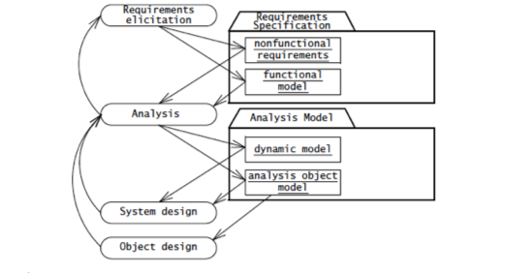
Analysis Model
Analysis focuses to prepare Analysis model, which is correct, complete, consistent, and verifiable.

Slide 6
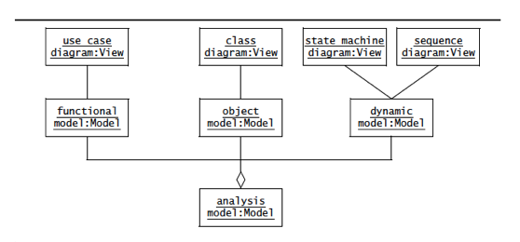
Analysis Model
Types of Analysis Models
a)The functional model :represented by use cases and scenarios
b)The analysis object model: represented by class and object diagrams
c)The dynamic model: represented by state machine and sequence diagrams

Slide 7
Analysis Model
These models represent user-level concepts, not actual software classes components
•Analysis Object Model
•Focuses on the individual concepts that are manipulated by the system, their properties and their relationships.
•Depicted with UML class diagrams, includes classes, attributes, and operations.
•A visual dictionary of the main concepts visible to the user.
•Dynamic model
• Focuses on the behaviour of the system.
•Depicted with sequence diagrams and with state machines.
•Sequence diagrams represent the interactions among a set of objects during a single use case.
•State machines represent the behaviour of a single object (or a group of very tightly coupled objects).
•Serves to assign responsibilities to individual classes and, in the process, to identify new classes, associations, and attributes to be added to the analysis object model.

Slide 8
Analysis Model
Activity Diagram
An activity diagram describes the behavior of a system in terms of activities.
Activity diagram is basically a flowchart to represent the flow form one activity to another activity.
Activity diagram: operation of a system.
This flow can be sequential, branched or concurrent.

Slide 9
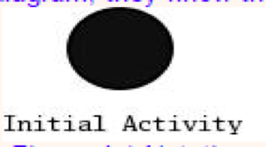
Analysis Model
Activity Diagram Basic Notations
•Initial node.
The filled in circle is the starting point of the diagram.
It is shown as filled circle.

Slide 10

Analysis Model
Activity Diagram Basic Notations
•Final node.
The filled in circle with a border at the end point of the diagram.
It is optional

Slide 11


Analysis Model
Activity Diagram Basic Notations
•Activity. The rounded rectangles represent activities that occur
•Flow/edge (Control Flow)
The arrows on the diagram. Within the control flow an incoming arrow starts a single step of an activity; after the step is completed the flow continues along the outgoing arrow.

Slide 12
Analysis Model
Activity Diagram Basic Notations
•Decision: are branches in the control flow.
They denote alternatives based on a condition of the state of an object or a set of objects.
Decisions are depicted by a diamond with one or more incoming open arrows and two or more outgoing arrows.
The outgoing edges are labeled with the conditions that select a branch in the control flow.
The set of all outgoing edges from a decision represents the set of all possible outcomes.

Slide 13
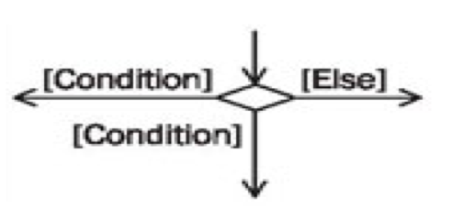
Analysis Model
Activity Diagram Basic Notations
•Decision:

Slide 14
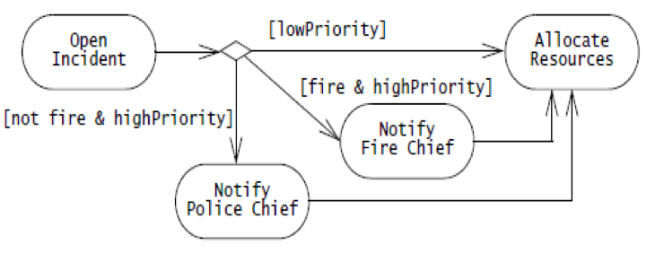
Analysis Model
Activity Diagram Basic Notations
•Decision:

Slide 15
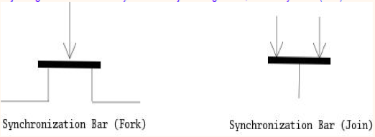
Analysis Model
Activity Diagram Basic Notations
Some activities occur simultaneously or in parallel. Such activities are called concurrent activities.
Fork nodes denote the splitting of the flow of control into multiple threads.
Join nodes denotes the synchronization of multiple threads and their merging of the flow of control into a single thread.
Fork nodes and join nodes represent concurrency.

Slide 16
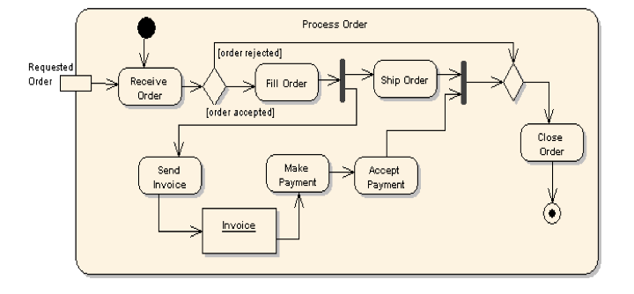
Analysis Model

Slide 17
Analysis Model
Activity Diagram : Swimlane
The contents of an activity diagram may be organized into partitions (swimlanes) using solid vertical lines.
A swim lane (or swimlane diagram) is a visual element used in process flow diagrams, or flowcharts, that visually distinguishes job sharing and responsibilities for sub-processes of a business process.
Order Swimlanes in a Logical Manner.
Apply Swimlanes To Linear Processes.
Have Less Than Five Swimlanes.
Consider Swim areas For Complex Diagrams.

Slide 18
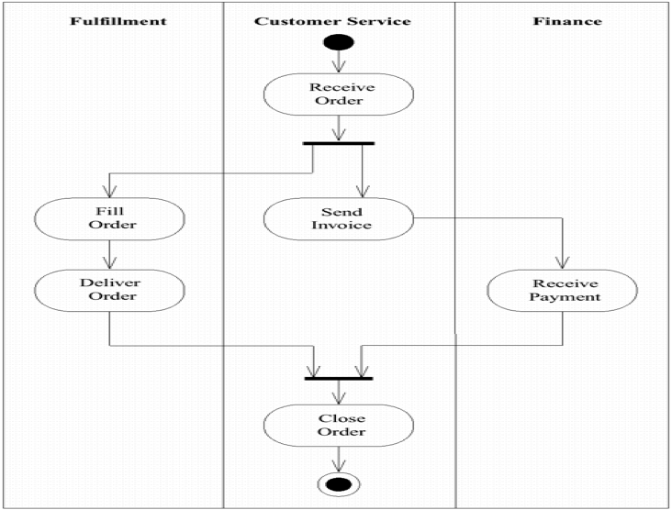
Analysis Model

Slide 19
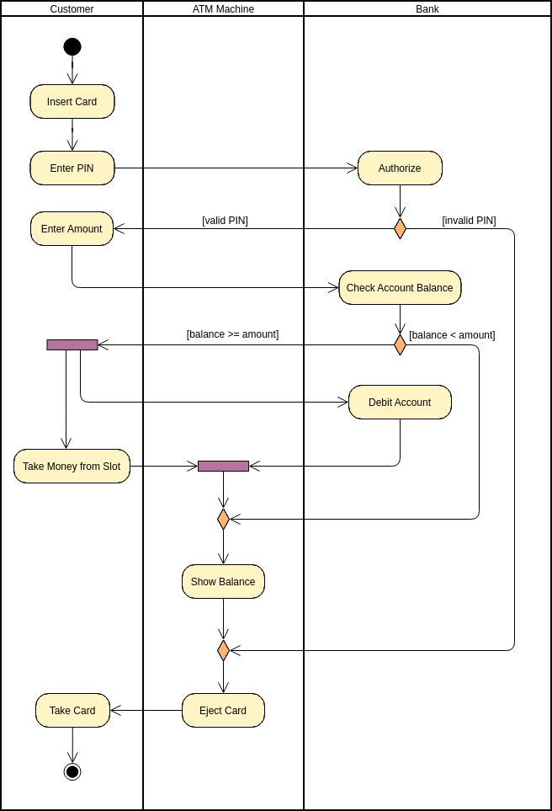
ATM Transaction System

Slide 20
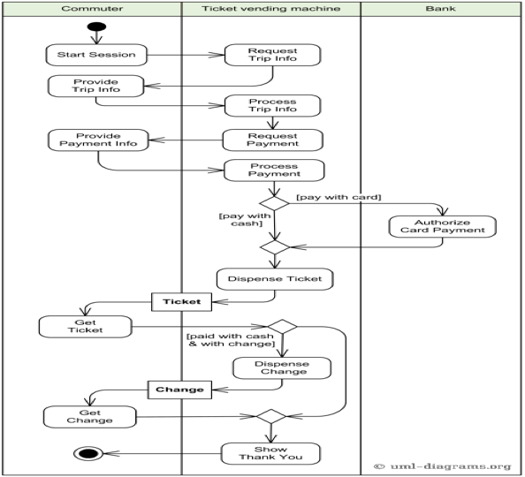
Analysis Model- Ticket Vending Machine

Slide 21
Analysis Model
Sequence Diagram:
•The Sequence Diagram models the collaboration of objects based on a time sequence.
•Sequence diagrams represent the objects participating in the interaction horizontally and time vertically.
•Depicts sequence of actions that occur in a system
•Useful tool to represent dynamic behavior of a system
•2 dimensional :
-Horizontal axis
-Vertical axis

Slide 22
Analysis Model
Sequence Diagram:
•The focus is less on messages themselves and more on the order in which messages.
•Sequence diagrams are good at showing which objects communicate with which other objects; and what messages trigger those communications.

Slide 23
Analysis Model
Participant in Sequence Diagram:
A sequence diagram is made up of a collection of participants.
Participants – the system parts that interact each other during the sequence.
Classes or Objects – each class (object) in the interaction is represented by its named icon along the top of the diagram

Slide 24
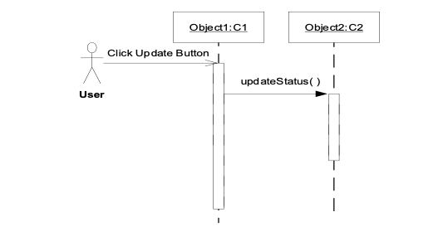
Analysis Model
Elements of Sequence Diagram:
•Actor
•Objects
•Lifelines
•Messages
•Activation: represents time an object needs to complete task

Slide 25

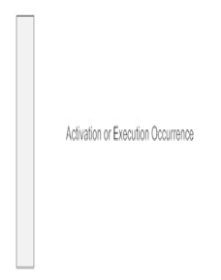
Analysis Model
Elements of Sequence Diagram:
•Class Roles or Participants or Objects: Class roles describe the way an object will behave in context.
Activation or Execution Occurrence
When an object is busy executing a process or waiting for a reply message, use a thin gray rectangle placed vertically on its lifeline.

Slide 26

Analysis Model
Elements of Sequence Diagram:
•Synchronous Message
•A synchronous message requires a response before the interaction can continue.
•It's usually drawn using a line with a solid arrowhead pointing from one object to another.

Slide 27
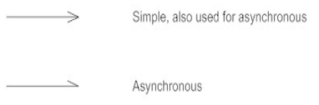
Analysis Model
Elements of Sequence Diagram:
Asynchronous Message
Asynchronous messages don't need a reply for interaction to continue.
They are drawn with an arrow connecting two lifelines; however, the arrowhead is usually open and there's no return message depicted

Slide 28

Analysis Model
Elements of Sequence Diagram:
•Reply or Return Message
A reply message is drawn with a dotted line and an open arrowhead pointing back to the original lifeline

Slide 29
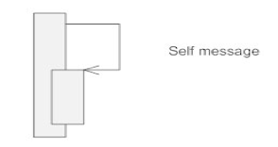
Analysis Model
Elements of Sequence Diagram:
•Self Message
•A message an object sends to itself, usually shown as a U shaped arrow pointing back to itself.

Slide 30


Analysis Model
Elements of Sequence Diagram:
•Lost: A lost message occurs when the sender of the message is known but there is no reception of the message.
•Found: A found message indicates that although the receiver of the message is known in the current interaction fragment, the sender of the message is unknown.

Slide 31
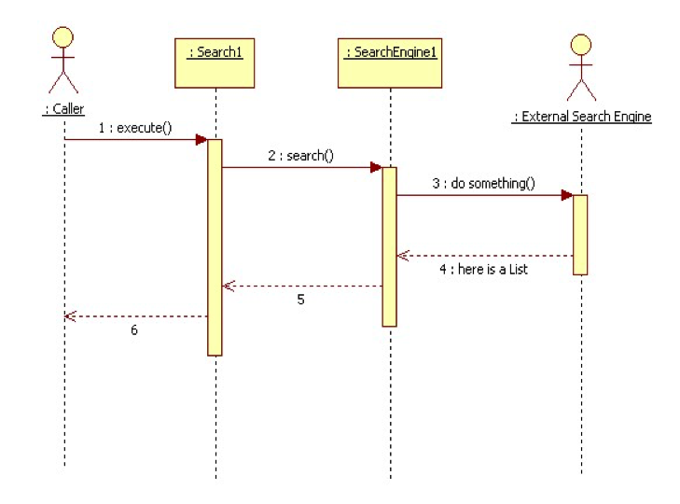
Analysis Model
Sequence Diagram

Slide 32
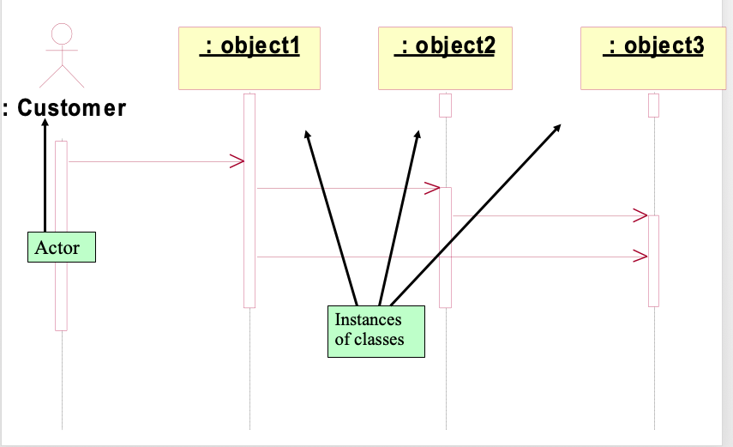
Analysis Model
Sequence Diagram

Slide 33
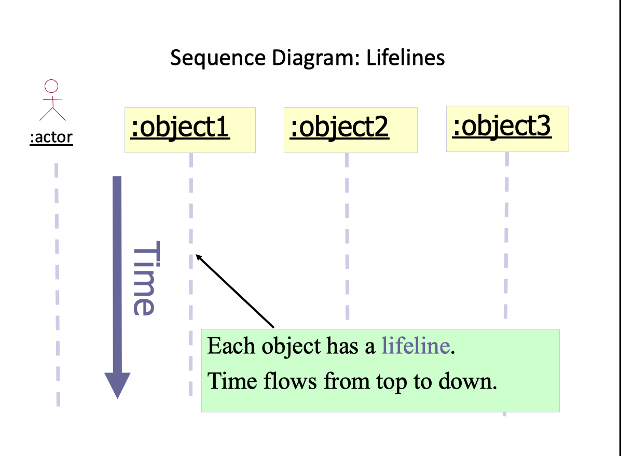
Analysis Model
Sequence Diagram

Slide 34
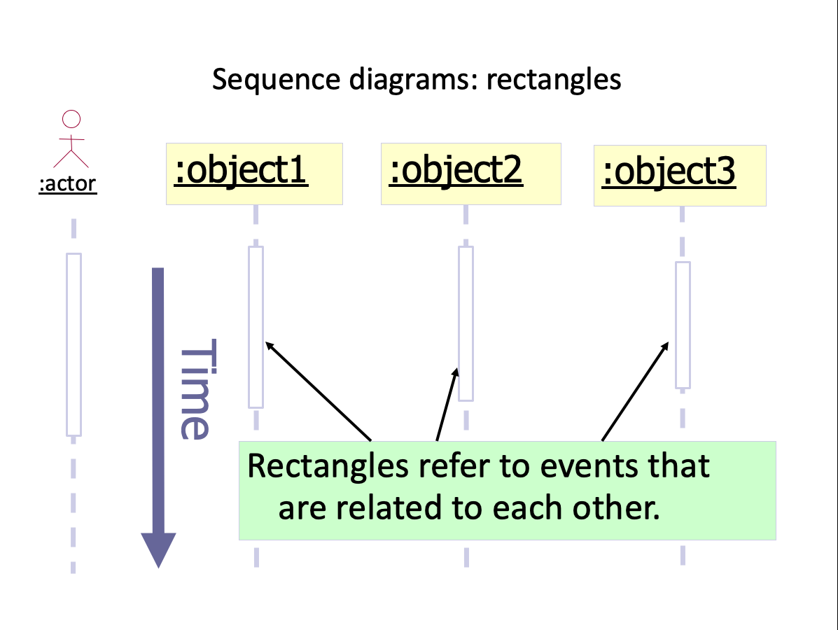
Analysis Model
Sequence Diagram

Slide 35
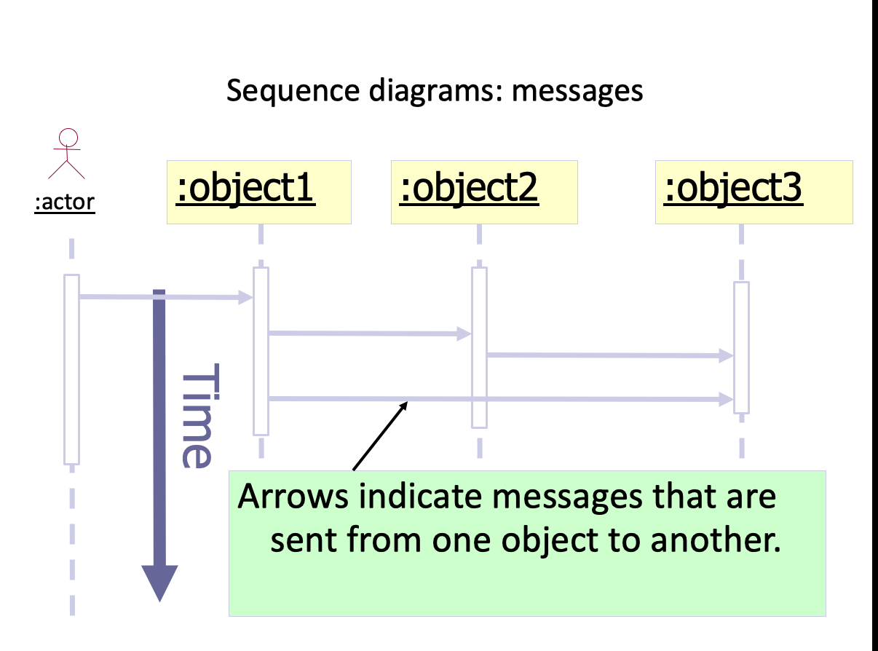
Analysis Model
Sequence Diagram

Slide 36
Analysis Model
Sequence Diagram

Slide 37
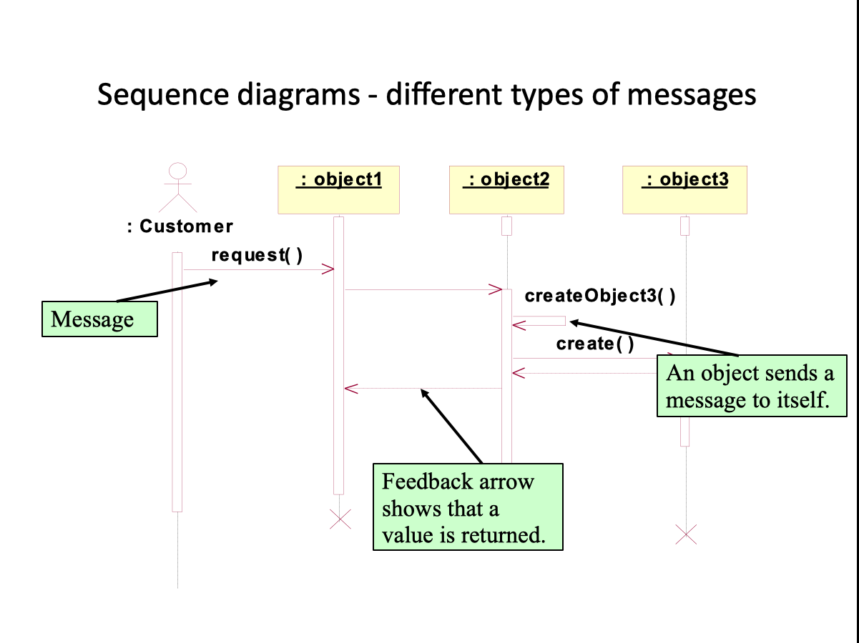
Analysis Model
Sequence Diagram

Slide 38
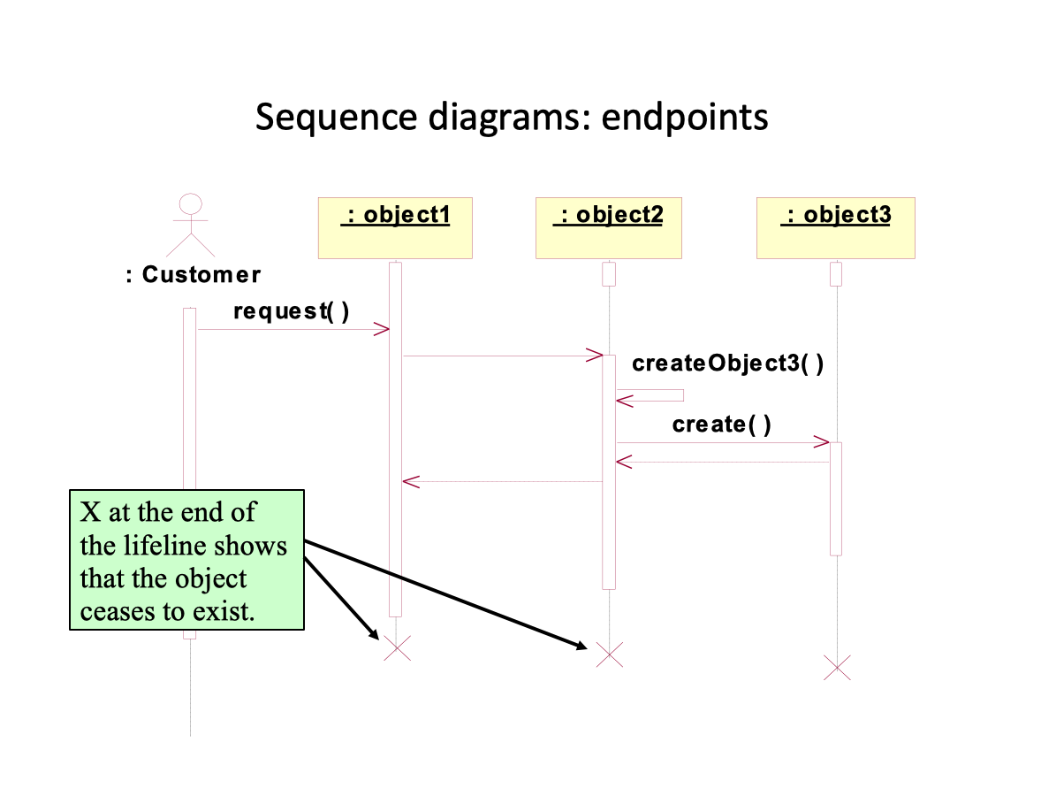
Analysis Model
Sequence Diagram

Slide 39
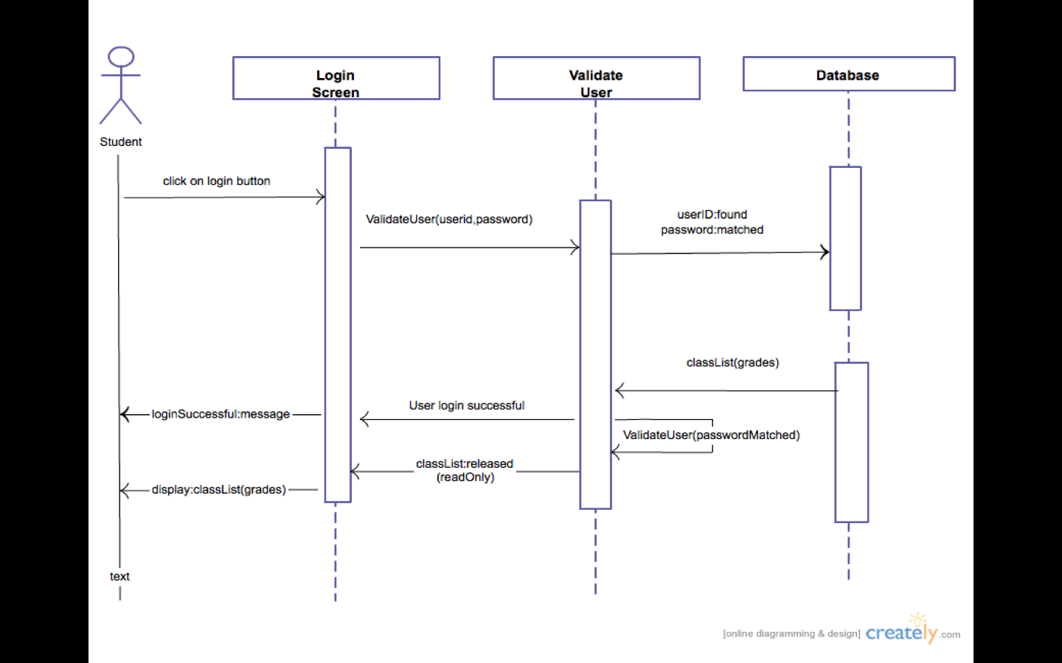
Analysis Model
Sequence Diagram diagram for login process

Slide 40
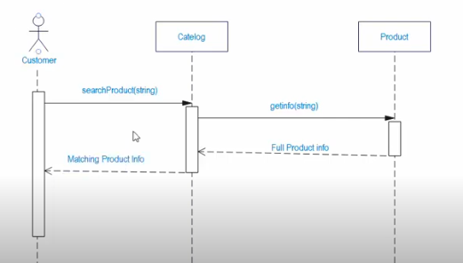
Example: online product search

Slide 41
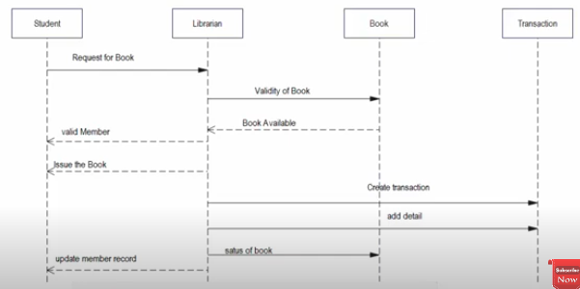
Example: Library management system

Slide 42
Analysis Model
Class Diagram: describes structure of the system
shows the system's
Classes
Attributes
Operations (or methods),
Relationships among the classes.

Slide 43
Analysis Model
Class Diagram
Class: A class represents the blueprint of its objects.
Attributes
Operations
Relationships
Associations
Generalization
Realization
Dependencies.

Slide 44
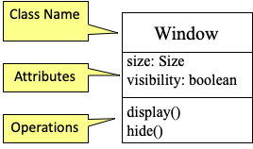
Analysis Model
Class Diagram
Class: Describes a set of objects having similar:
–Attributes (status)
–Operations (behavior)
–Relationships with other classes
•Attributes and operations may have their visibility marked:
"+" for public
"#" for protected
"−" for private
"~" for package

Slide 45

Analysis Model
Class Diagram
Class: Association Relationship
An association between two classes indicates that objects at one end of an association “recognize” objects at the other end and may send messages to them.
Example: “An Employee works for a Company”

Slide 46
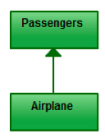
Analysis Model
Class Diagram
Class: Direct Association Relationship
Refers to a directional relationship represented by a line with an arrowhead. The arrowhead depicts a container-contained directional flow.

Slide 47
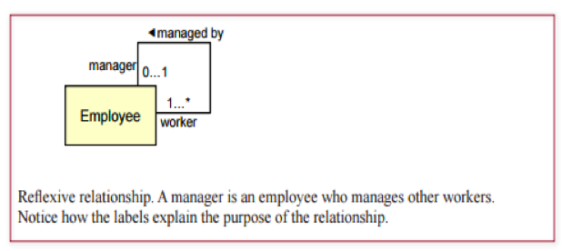
Analysis Model
Class Diagram
Class: Reflexive Association Relationship
Relationship from one class back to itself

Slide 48
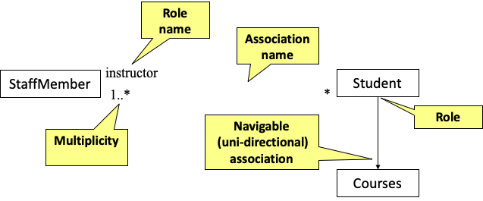
Analysis Model
Class Diagram

Slide 49
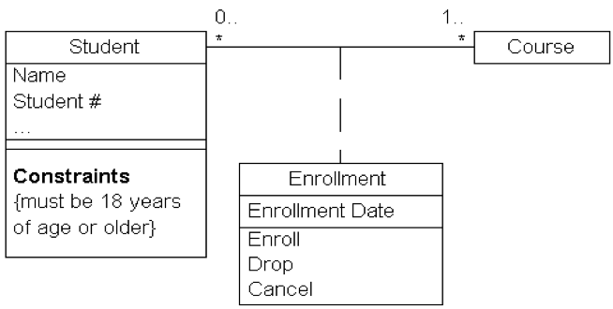
Analysis Model
Class: Association Class
include another class to add valuable information about the relationship.
use an association class to tie the primary association.
An association class is represented like a normal class.
The difference is that the association line between the primary classes intersects a dotted line connected to the association class.

Slide 50
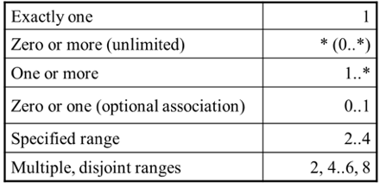
Analysis Model
Class Diagram
Multiplicity:
•the number of objects that participate in the association.
•Multiplicity Indicators

Slide 51
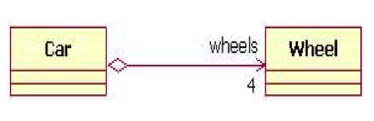
Analysis Model
Class Diagram
Aggregation
•Aggregation is a special type of association used to model a "whole to its parts" relationship.
•Example: Car as a whole entity and Car Wheel as part of the overall Car.

Slide 52
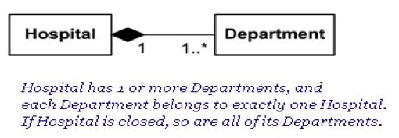
Analysis Model
Class Diagram
Composite Aggregation
•A strong form of aggregation
–The whole is the sole owner of its part.
•The part object may belong to only one whole
–Multiplicity on the whole side must be zero or one.
–The life time of the part is dependent upon the whole.

Slide 53
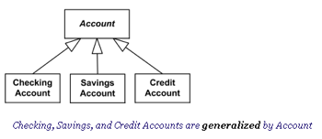
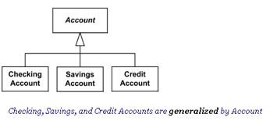
Analysis Model
Class Diagram
Generalisation:
•The Generalization association ("is a") is the relationship between the base class that is named as “superclass” or “parent” and the specific class that is named as “subclass” or “child”.

Slide 54
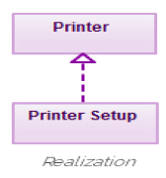
Analysis Model
Class Diagram
Realisation:
A realization relationship indicates that one class implements a behaviour specified by another class (an interface or protocol).
a broken line with hollow arrowhead pointing is drawn from the class that defines the functionality to the class that implements the function.

Slide 55
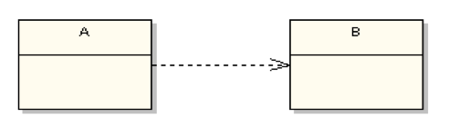
Analysis Model
Class Diagram
Dependency:
It means that the class at the source end of the relationship has some sort of dependency on the class at the target (arrowhead) end of the relationship.
In UML, a dependency relationship is a relationship in which one element, the client, uses or depends on another element, the supplier.
Dependency shows that an element is dependent on another element as it fulfils its responsibilities within the system

Slide 56
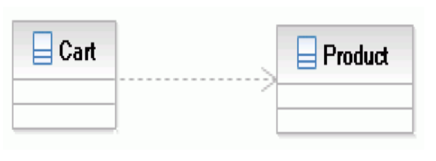
Analysis Model
Class Diagram
Dependency:
A Cart class depends on a Product class because the Cart class uses the Product class as a parameter for an add operation.
Cart class is, therefore, the client, and the Product class is the supplier.

Slide 57
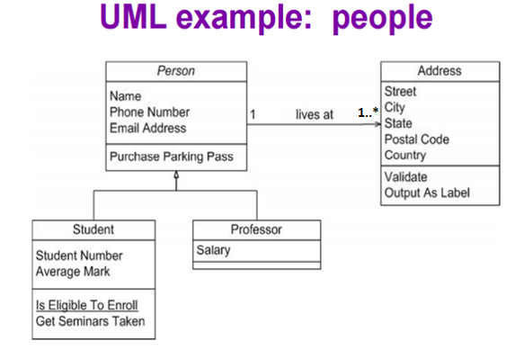
Analysis Model
Class Diagram

Slide 58
Collaboration Diagram
It is also called Communication Diagram.
A Collaboration Diagram is a type of Interaction Diagram that visualizes the interactions and relationships between objects in a system.
It shows how objects collaborate to achieve a specific task or behavior.
These diagrams are used to model the dynamic behavior of a system and illustrate the flow of messages between objects during a particular scenario or use case.
Both the sequence and collaboration diagrams represent the same information, but the way of portraying it quite different.
The collaboration diagrams are best suited for analyzing use cases.

Slide 59
Steps for creating a Collaboration Diagram
Step 1: Identify Objects/Participants: Begin by identifying the objects or participants involved in the system. These can be classes, modules, actors, or any other relevant entities.
Step 2: Define Interactions: Determine how these objects interact with each other to accomplish tasks or scenarios within the system. Identify the messages exchanged between objects during these interactions.
Step 3: Add Messages: Draw arrows between lifelines to represent the messages exchanged between objects. Label each arrow with the name of the message and, if applicable, any parameters or data being transmitted.
Step 4: Consider Relationships: If there are associations or dependencies between objects, represent them using appropriate notations, such as dashed lines or arrows.
Step 5: Documentation: Once finalized, document the collaboration diagram along with any relevant explanations or annotations. Ensure that the diagram effectively communicates the system’s interactions to stakeholders.

Slide 60
Analysis Model
Collaboration Diagram:
Emphasis on structural organization of the objects that send and receive messages
Elements of Collaboration diagram:
Objects:
Relations/ associations
Messages function()
Object 1
Object 2

Slide 61
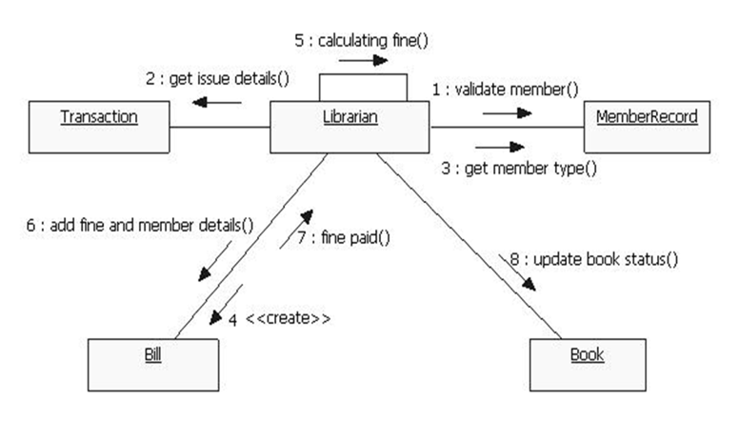
Analysis Model
Collaboration Diagram:

Slide 62
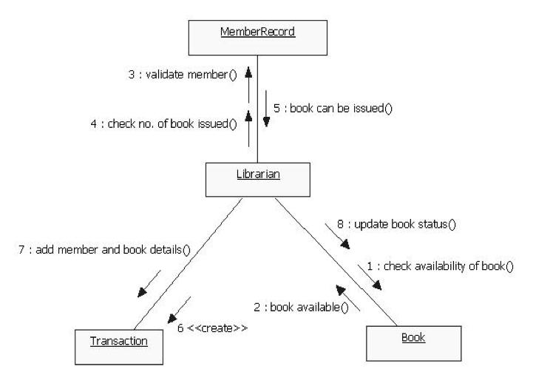
Analysis Model
Collaboration Diagram:

Slide 63
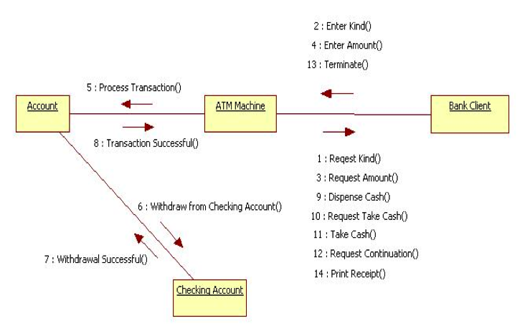
Analysis Model
Collaboration Diagram:

Slide 64
Analysis Model
State Chart Diagram:
A state in UML is a condition or situation an object (in a system) might find itself in during its life time.
Normally used to model how the state of an object changes in its lifetime.
Used to capture the behavior of the subject object through modeling these various states and transitions between them.
Does not necessarily model all possible states, but rather the critical ones only, those that act as stimuli and prompt for response in the external world.

Slide 65
Analysis Model
State Chart Diagram:
Elements of state chart diagram
State: Represented by rectangles with rounded corners.
Initial state: Represented as a filled circle.
Final state: Represented by a filled circle inside a larger circle.
Transition: Shown as an arrow between two states. Normally, the name of the event which causes the transition is places alongside the arrow.
A guard condition (Event):
It is any internal or external trigger that causes system to change its state.
Example: Internal event: timer expiry and External event: user presses some switch.

Slide 66
Analysis Model
State Chart Diagram:
Elements of state chart diagram
State:
Initial state:
Final state:
Transition:
A guard condition: Event[Guard condition/action]
State

Slide 67
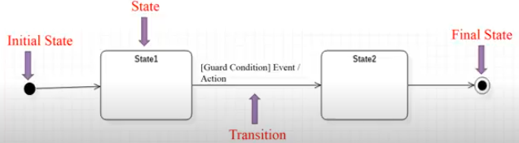
State diagram:

Slide 68
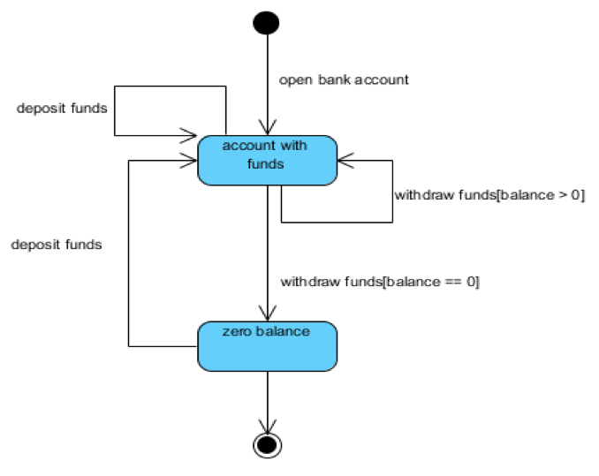
Analysis Model
State Chart Diagram:

Slide 69
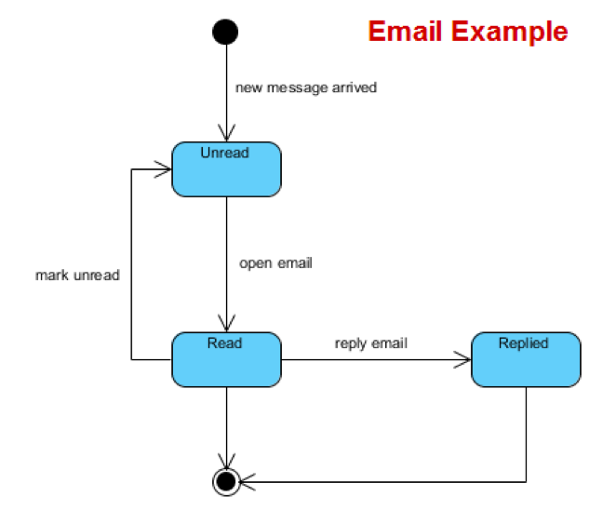
Analysis Model
State Chart Diagram:

Slide 70
Component Diagram
It describes the organization and wiring of the physical components in a system.
Component diagrams are often drawn to help model implementation details and double-check that every aspect of the system's required functions is covered by planned development.
In UML 2, these components are less physical and more conceptual stand-alone design elements such as a business process that provides or requires interfaces to interact with other constructs in the system.

Slide 71

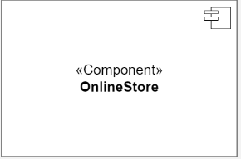
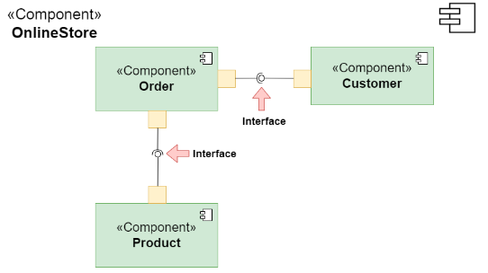
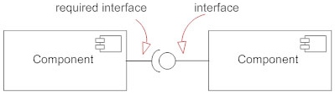
Component
A component is a logical unit block of the system, a slightly higher abstraction than classes. It is represented as a rectangle with a smaller rectangle in the upper right corner with tabs or the word written above the name of the component to help distinguish it from a class.
Interface
An interface (small circle or semi-circle on a stick) describes a group of operations used (required) or created (provided) by components. A full circle represents an interface created or provided by the component. A semi-circle represents a required interface, like a person's input.

Slide 72
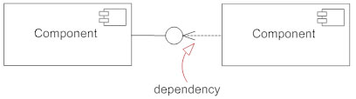
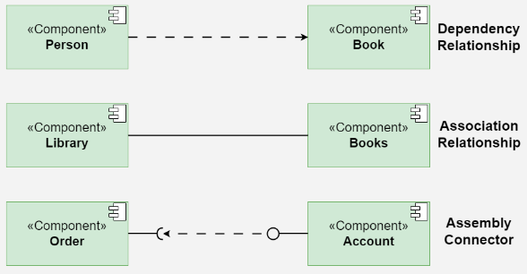
Relationships:
Depict the connections and dependencies between components and interfaces.
Symbol: Lines and arrows.
Dependency (dashed arrow): Indicates that one component relies on another.
Association (solid line): Shows a more permanent relationship between components.
Assembly connector: Connects a required interface of one component to a provided interface of another.

Slide 73
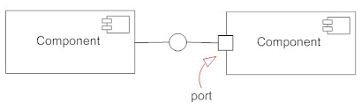
Port
Ports are represented using a square along the edge of the system or a component. A port is often used to help expose required and provided interfaces of a component.

Slide 74

A component diagram for an online shopping system:

Slide 75
Deployment diagram
Deployment diagrams is a kind of structure diagram used in modeling the physical aspects of an object-oriented system.
They are often be used to model the static deployment view of a system (topology of the hardware).
A Deployment Diagram illustrates how software architecture, designed on a conceptual level, translates into the physical system architecture where the software will run as nodes.
It maps out the deployment of software components onto hardware nodes and depicts their relationships through communication paths, enabling a visual representation of the software’s execution environment across multiple nodes.

Slide 76
Key elements of a Deployment Diagram
1. Nodes
These represent the physical hardware entities where software components are deployed, such as servers, workstations, routers, etc.
2. Components
Represent software modules or artifacts that are deployed onto nodes, including executable files, libraries, databases, and configuration files.
3. Artifacts
Physical files deployed onto nodes, embodying the actual implementation of software components, such as executables, scripts, databases, etc.
4. Dependencies
Reflect relationships or connections between nodes and components, indicating communication paths, deployment constraints, or other dependencies.
5. Associations
Show relationships between nodes and components, signifying that a component is deployed on a particular node, thus mapping software components to physical nodes.
6. Deployment Specification
Describes the configuration and properties of nodes and components, encompassing hardware specifications, software configurations, communication protocols, etc.
7. Communication Paths
Represent channels or connections facilitating communication between nodes and components, including network connections, communication protocols, etc.

Slide 77





Notations
Component
Artifact
Interface
Nodes
Communication path
A straight line that represents communication between two device nodes. Dashed lines in deployment diagrams often signify relationships or dependencies between elements, indicating that one element is related to or dependent on another.

